Slide 1

ANGULAR 4

Slide 2
Data with Http
Getting Data with Http
Http
Adding Exception Handling for Http
RxJs
Async Pipe
Adding an Async Pipe with an Observable

Slide 3
Data with Http
Getting Data with Http

Slide 4
Data with Http
Http

Slide 5
Data with Http
We use Http to get and save data with Observables. We isolate the http calls in a shared Service.

Slide 6
Data with Http
Http Requirements
1 – Import modules
Import { NgModule } from ‘@angular/core’;
Import { BrowserModule } from ‘@angular/platform-browser’;
Import { HttpModule } from ‘@angular/http’;
Import ‘./rxjs-extensions’;
Import { AppComponent } from ‘./app.component’;
Import { ShipsListComponent } from ‘./ship-list.component’;
@NgModule({
imports: [BrowserModule, HttpModule],
declarations: [AppComponent, ShipListComponent],
bootstrap: [AppComponent]
})
export class AppModule {}

Slide 7
Data with Http
Http Requirements
2 – Define a service
ship.service.ts
@Injectable()
export class shipService {
constructor(private http: Http)
getShips() {
return this.http.get(‘api/ships’)
.map((response: Response) => <Ship[]>response.json().data)
.catach(this.handleError);
}
private handleError(error: Response) { // }
}

Slide 8
Data with Http
Http Requirements
3 – Subscribing to the Observable
Ship-list.component.ts
//…..
Constructor(private shipService: ShipService) {}
ngOnInit() {
this.shipService.getShips()
.subscribe(
s => this.ships = s,
error => this.errorMessage = <any>error
);
}

Slide 9
Data with Http
Http Requirements
Demo

Slide 10
Data with Http
Adding Exception Handling for Http

Slide 11
Data with Http
ship.service.ts
import { Injectable } from '@angular/core';
import { Http, Response } from '@angular/http';
import { Observable } from 'rxjs/Observable';
Import ‘rxjs/add/operator/map’;
Import ‘rxjs/add/operator/catch’;
Import ‘rxjs/add/observable/throw’;
@Injectable()
export class shipService {
constructor(private http: Http)
getShips() {
return this.http.get(‘api/ships’)
.map((response: Response) => <Ship[]>response.json().data)
.catch(this.handleError);
}
private handleError(error: Response) {
let msg = ` Status Code ${error.status} on url ${error.url}`;
return Observable.throw(msg)
}
}

Slide 12
Data with Http
RxJs

Slide 13
Data with Http
RxJs (Reactive Js) implements the asynchronous observable pattern and is widely used in Angular 2.

Slide 14
Data with Http
RxJs (Reactive Js) implements the asynchronous observable pattern and is widely used in Angular 2.

Slide 15
Data with Http
Import all of RxJs
Selective Import of RxJs
Import ‘rxjs/add/operator/catch’;
Import ‘rxjs/add/operator/do’;
Import ‘rxjs/add/operator/map’;
Import ‘rxjs/Rx’;
Rxjs.extensions.ts
App.module.ts
Import ‘./rxjs-extensions’;
App.module.ts

Slide 16
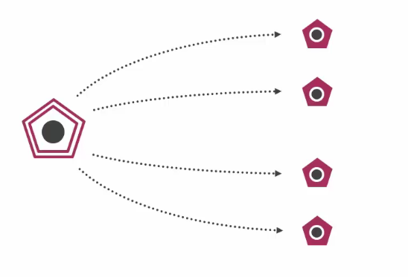
Data with Http
How does it work
Subscription A
Subscription B
Observable A
Subscription C
Subscription D
Note: http module automatically unsubscribes when is finished

Slide 17
Data with Http
Async Pipe

Slide 18
Data with Http
The Async Pipe receives a Promise or Observable as input and subscribes to the input, eventually emitting the value as changes arrive.

Slide 19
Data with Http
Ship-list.component.ts
//…..
Constructor(private shipService: ShipService) {}
this.ships: Observable<Ship[]>;
ngOnInit() {
this.ships = this.shipService.getShips();
}
Ship-list.component.html
<li *ngFor=“let ship of ships | async”>
{{ ship.name }}
</li>

Slide 20
Data with Http
Demo
Adding an Async Pipe with an Observable

